Slide 1





NORTH SOUTH UNIVERSITY
PROJECT TOPIC PROPOSAL
Presented by
ABDULLAH AL RAIYAN - 2212712042
MD. SIFAT HAQUE ZIDAN - 2212768042
RAHIL MEHNAZ - 2121843042

Slide 2


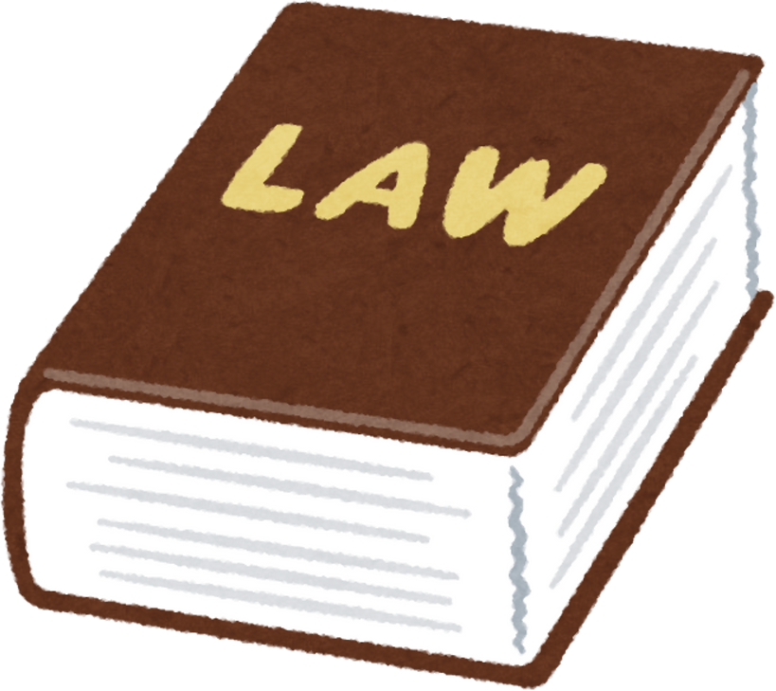
OUR PROPOSED TOPIC-1
1.
NLP-Based AI Model for Legal Assistance in Bangladesh: Enhancing Access to Law and Citizen Rights

Slide 3

IDEA BEHIND THIS PROJET
An AI-powered legal assistant designed to help citizens of Bangladesh understand their rights & navigate legal matters. This NLP-driven application:
  will be trained on publicly available Bangladeshi law books & legal resources
  enabling it to answer user queries
  provide insights on various legal topics, including the right to information, consumer protection, tax laws, labor rights, & more.
Goal:
  to make legal knowledge more accessible, empowering users with accurate, reliable, & easy-to-understand legal guidance.

Slide 4
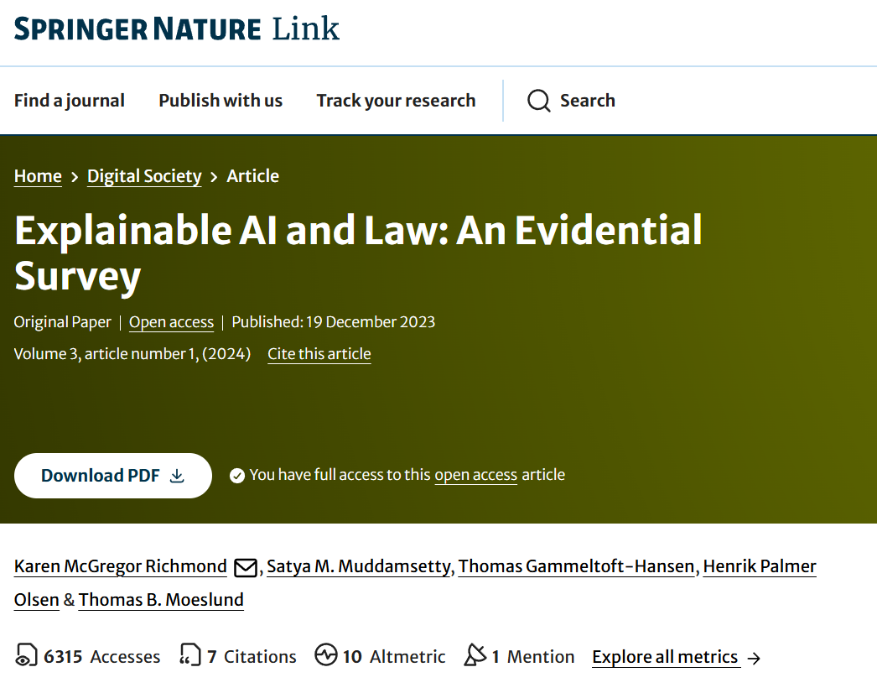
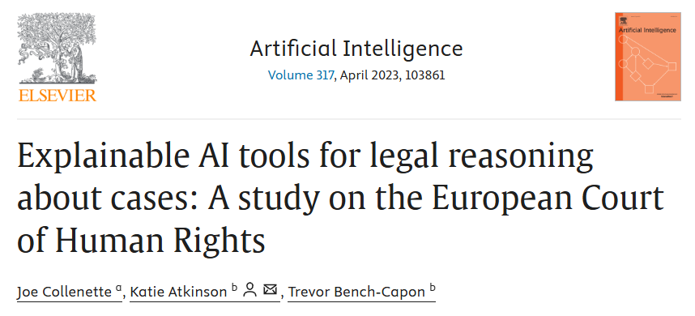
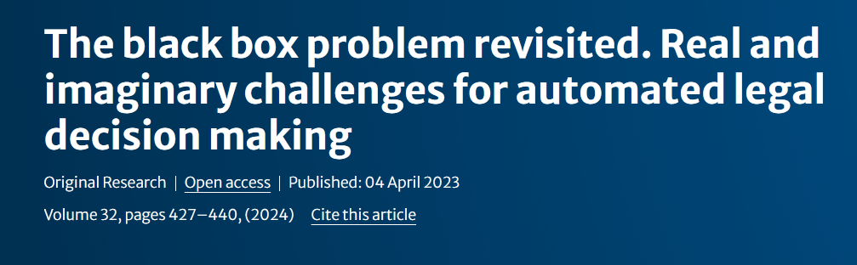
RELATED WORKS ON THIS TOPIC
Publication Date: 10 December 2023
Publication Date: 20 April 2023
Publication Date: 04 April 2023

Slide 5
LITERARY REVIEW
01
02
03
This paper implements and evaluates explainable decision-support tools for deciding legal cases, specially under the European Convention of human rights. So that explainations are understandable to the users.
This paper explores the black-box problem in AI and particularly in the legal context. It arises issues such as opacity, justification etc. And they analyze and unpredictability and suggest ways to mitigate them.
The authors emphasize the importance of understanding the heterogeneous nature of legal reasoning and the need for AI systems to be designed with explainability in mind.

Slide 6
WHAT WE WANT TO DO
TRAIN AN AI MODEL ON BANGLADESHI LAWS
We will use the publicly available Bangladeshi laws found at http://bdlaws.minlaw.gov.bd/ to train our model
CREATE AN APPLICATION/CHAT BOT
After training the model, we will integrate it into a mobile/web app, enabling users to easily access legal information. The app will allow people to ask queries regarding their rights and laws. This will make legal information more accessible and efficient for users in Bangladesh.

Slide 7
CHALLENGES
PROBLEM 1
PROBLEM 2
The Laws of Bangladesh (http://bdlaws.minlaw.gov.bd/) is presented in both English and Bangla, creating challenges for NLP model training. This linguistic inconsistency complicates text preprocessing.
Developing an AI model for legal advice may have unforeseen legal implications, including liability risks and regulatory challenges, which need careful consideration.

Slide 8
WHY THIS TOPIC?
  Lack of Legal Awareness – Many citizens struggle to access clear, reliable legal information.
  Complexity of Laws – Legal language is difficult for the general public to understand.
  High Legal Costs – Legal aid is often expensive and not easily accessible.
  AI for Empowerment – An AI assistant can provide instant, accurate, and easy-to-understand legal guidance.
  Better Access to Justice – Helps citizens make informed decisions and understand their rights.

Slide 9
WHAT MAKES OUR PROPOSAL UNIQUE
Localized Legal Expertise – Unlike generic legal chatbots, this application is specifically trained on Bangladeshi laws, regulations, and legal precedents, ensuring contextually relevant answers.

Slide 10



OUR PROPOSED TOPIC-2
2.
Personalized Vacation Planning Using Machine Learning & Deep Learning

Slide 11

IDEA BEHIND THIS PROJET
A smart vacation planner:
  generates personalized itineraries tailored to the user's desired travel experience, whether it's adventurous or relaxing.
  gathers key details from the user, such as destination, travel dates, trip duration, and budget, to craft an optimized plan.
  considering the user’s preferences & combining real-time data, the planner will recommend activities, accommodations, and travel routes that align with the user's ideal vacation.

Slide 12
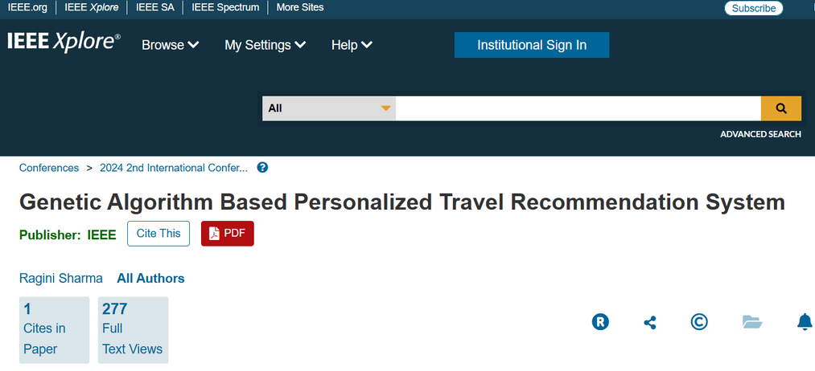
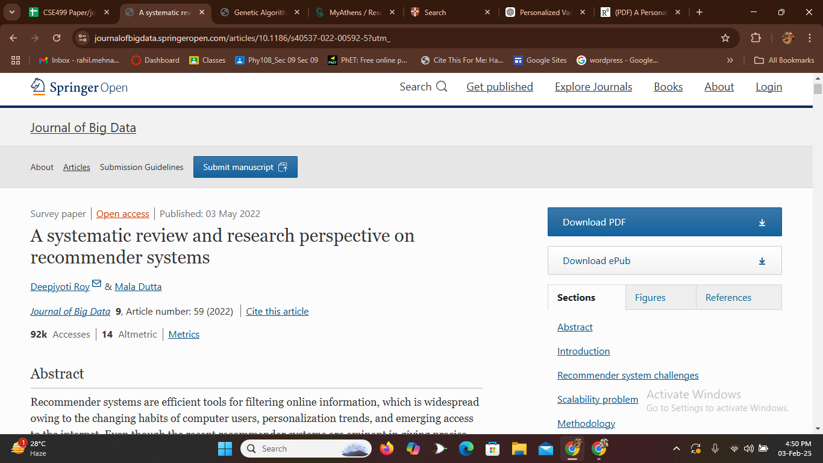
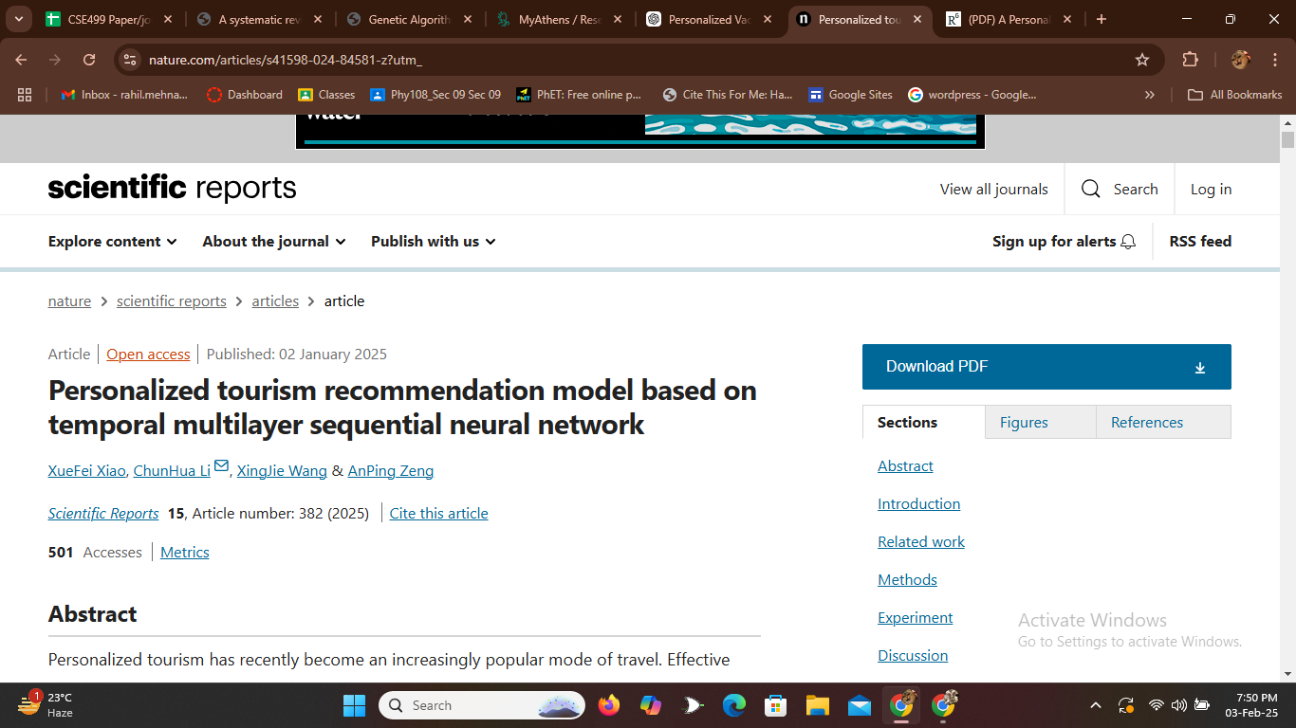
RELATED WORKS ON THIS TOPIC
Publication Date: 22 March 2024
Publication Date: 22 May 2022
Publication Date: 2 January 2025

Slide 13
LITERARY REVIEW
01
02
03
This paper provides a systematic review of recommender systems, exploring the applications, techniques & challenges while also recognizes the research gaps & suggests future directions.
This paper proposes a model called TMS(Temporal Multilayer Sequential) Neural Network to enhance recommendations by accurately predicting user preferences & travel behaviors, thus offering a better tourism experience.
The paper is based on incorporating user preferences into a genetic algorithm that results in an personalized travel route recommendation.

Slide 14
WHAT WE WANT TO DO
COLLECT DATA FROM WEBSITE BY WEB- SCRAPPING
Collect relevant vacation/trip-related websites like https://www.touristplaces.com.bd/, https://tourismbangla.com/, https://www.tripadvisor.in/, https://nijhoom.com/, etc.
TRAIN AN AI MODEL BASED ON THE DATA
After collecting and preprocessing travel-related data, we will train an AI model to generate personalized vacation itineraries for users.
CREATE AN APP DEMONSTRATION
With the trained model, we will integrate it into a mobile/web app, enabling users to easily access personalized vacation plans.

Slide 15
CHALLENGES
PROBLEM 1
PROBLEM 2
Collecting website data is challenging due to noise, inconsistencies, and irrelevant content. Proper filtering and preprocessing are crucial to ensure accuracy and improve dataset quality for effective AI training.
As tourism trends evolve rapidly, collected data can quickly become outdated. Using transfer learning, the AI model can adapt efficiently to new data without full retraining, ensuring accurate and up-to-date recommendations.

Slide 16
WHY THIS TOPIC?
  Rising Popularity of Personalized Travel
2. Data Overload
3. Practical Applications & Industry Demand

Slide 17
WHAT MAKES OUR PROPOSAL UNIQUE
Personalized Vacation – Planned trip based on user preferences, whether they seek adventure in the hills of Bandarban or relaxation on the beaches of Cox’s Bazar.
Budget-Conscious Planning – Provides options for every budget, from luxurious resorts to budget-friendly stays and dining recommendations.

Slide 18
REFERENCES
TOPIC-1 Related References
1. Explainable AI & Law : An Evidential Survey
Link: https://link.springer.com/article/10.1007/s44206-023-00081-z
2. Explainable AI tools for legal reasoning about cases: A study on the European Court of Human Rights
Link: https://www.sciencedirect.com/science/article/pii/S0004370223000073
3. The black box problem revisited. Real and imaginary challenges for automated legal decision making
Link: https://link.springer.com/article/10.1007/s10506-023-09356-9

Slide 19
REFERENCES
TOPIC-2 Related References
1. Genetic Algorithm Based Personalized Travel Recommendation System
Link: https://link.springer.com/article/10.1007/s44206-023-00081-z
2. A systematic review and research perspective on recommender systems
Link: https://journalofbigdata.springeropen.com/articles/10.1186/s40537-022-00592-5?utm_
3. Personalized tourism recommendation model based on temporal multilayer sequential neural network
Link: https://www.nature.com/articles/s41598-024-84581-z?utm_

Slide 20
THANK YOU

